Slide 1
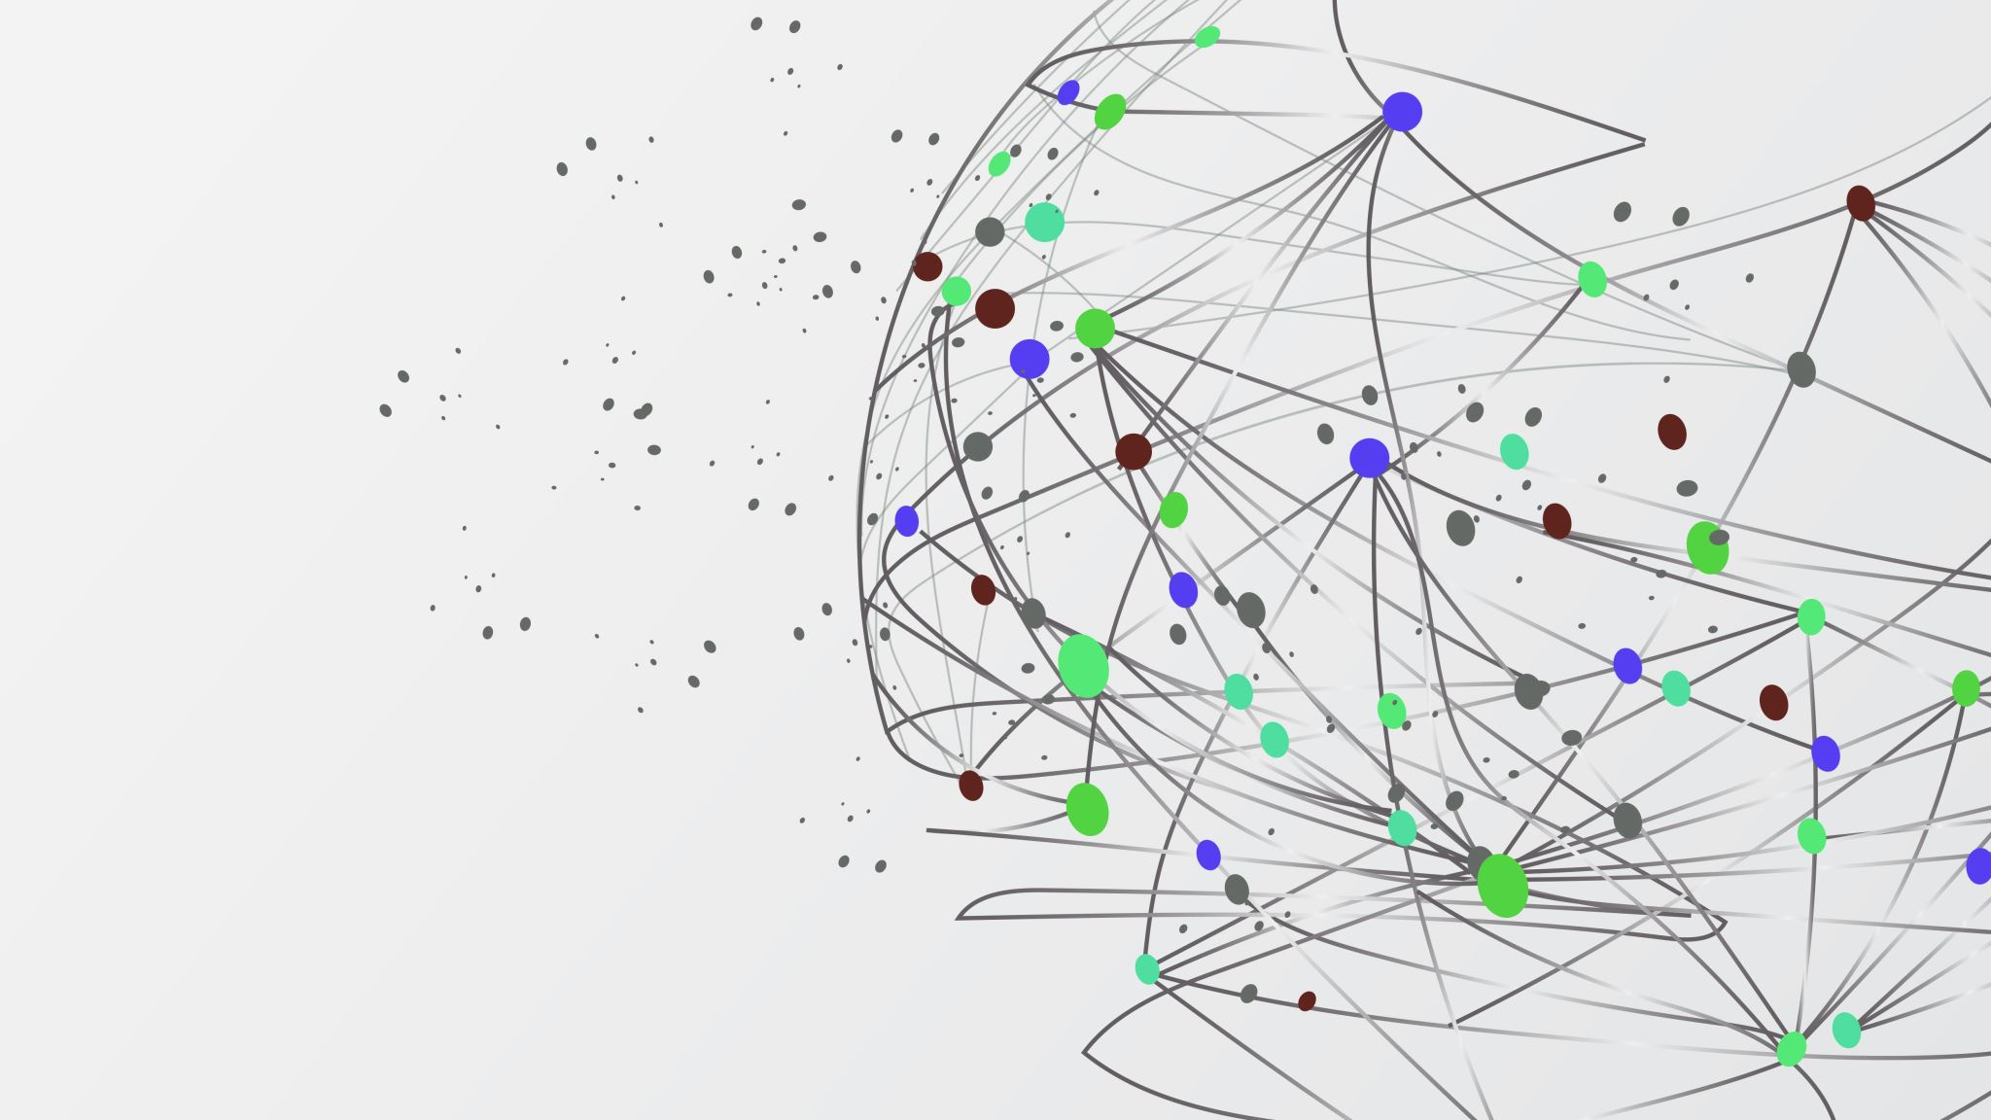
A Journey to Scrum
By Ally miller

Slide 2
Scrum Roles
Product owner – responsible for creating user stories, defining and prioritizing features, and maintaining the backlog.
Scrum Master – responsible for fostering an environment of collaboration, helping to remove obstacles in the team’s way, and guiding the team in embracing agile practices.
Developer – responsible for coding and delivering increments of the product during each sprint.
Tester – Responsible for designing and executing test cases and identifying any defects to ensure the quality of the product from a user’s perspective.

Slide 3
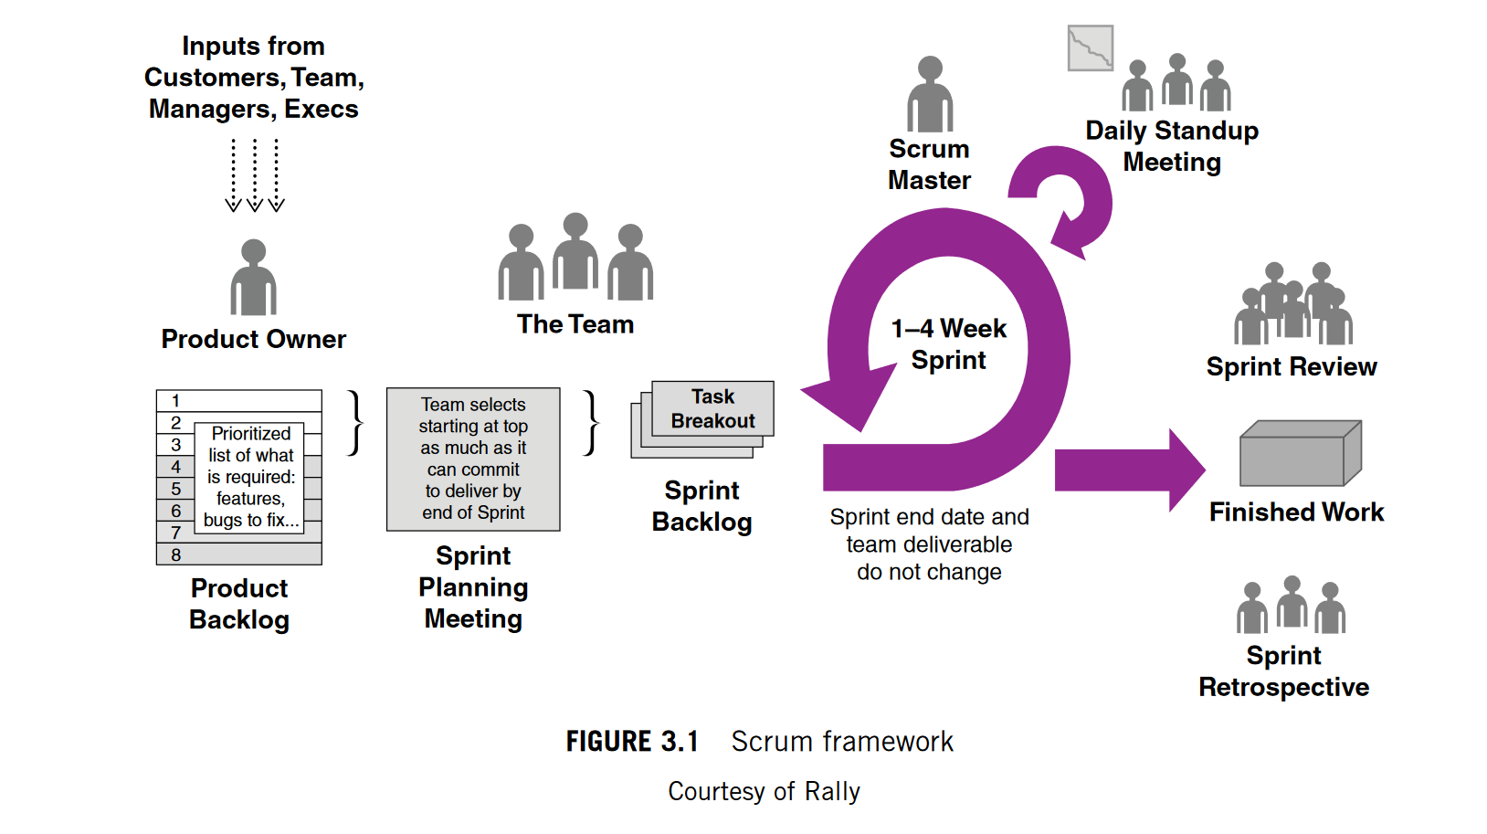

Slide 4
Phases of SOFTWARE Development Life Cycle
Planning (Concept) – Agile planning is adaptive and there are many ways to plan. Rolling wave planning is a method used that defers planning to the last responsible moment, or the last point in which a decision can be made without impacting the over all project,(Cobb, 2015). This is the phase where the team defines the product and estimates the time the product will take. The more information that is compiled during this time the better equipped the team will be.
Analysis – The analysis phase in agile can include refinement with the use of user stories. This is where the product owner will collaborate with shareholders and the development team to clarify requirements.

Slide 5
Phases of SOFTWARE Development Life Cycle
Design – The team will engage in continuous design discussions during sprint planning and development. This is where a UML diagram may be created to demonstrate how new features should function, (Lucid Content Team, 2017)
Implementation – Coding in agile involves development of the features based on user stories. Continuous integration practices should be included to ensure that code changes throughout the agile process are incorporated and tested frequently.
Testing – Testing occurs throughout the developmental process, not just at the end. Testers will work closely with developers to create and execute tests to identify any issues early in the process.

Slide 6
Phases of SOFTWARE Development Life Cycle
Deployment – releasing increments of product regularly within each sprint. This frequent release cycle allows for changes to be made easily and can ensure that the most important features are delivered first.
Feedback and maintenance– Agile emphasizes continuous feedback. During sprint reviews the team can reflect on their work and make improvements. Maintenance of product is important as well and is seen as an ongoing process.

Slide 7
Contrasting Waterfall and Agile
Waterfall is a more linear approach where phases are executed sequentially, and each phase is dependent on the completion of the previous phase. Planning for waterfall is done upfront and often changes are impossible to make after or can be costly to make. There is minimal customer involvement with the waterfall phase, and this can lead to late feedback making it difficult to address. Waterfall typically has long development times that can lead to a delayed product,(Cobb, 2015).
With agile development is iterative and incremental with small functionalities provided and tested regularly throughout the process. Plans are adaptive and change is welcome. Customer involvement in active in agile throughout the process with stakeholders providing feedback throughout. Agile can be a shorter development time due to short sprints that result in quicker functioning code.

Slide 8
Contrasting Waterfall and Agile
The SNHU travel application was better suited for agile. If we had used waterfall then last-minute changes, we faced would have been impossible to do. One change we were asked was to change the type of vacation packages in the top five destinations to more rejuvenating places. This change would have been hard to accomplish with the waterfall method but since agile fosters an environment suited for change it was an easy change to implement with very little issues.
The choice between waterfall and agile depends on the nature of the product, the level of uncertainty, and desired level of flexibility in responding to changes during development. If a product will not need any changes, then waterfall may be suitable, however if a product has uncertain design constraints, then agile would be better suited.

Slide 9
References
Charles G. Cobb. (2015). The Project Manager’s Guide to Mastering Agile : Principles and Practices for an Adaptive Approach. Wiley.
Lucid Content Team. (2017, December). The Stages of the Agile Software Development Life Cycle. Lucidchart.com. https://www.lucidchart.com/blog/agile-software-development-life-cycle

